Slide 1
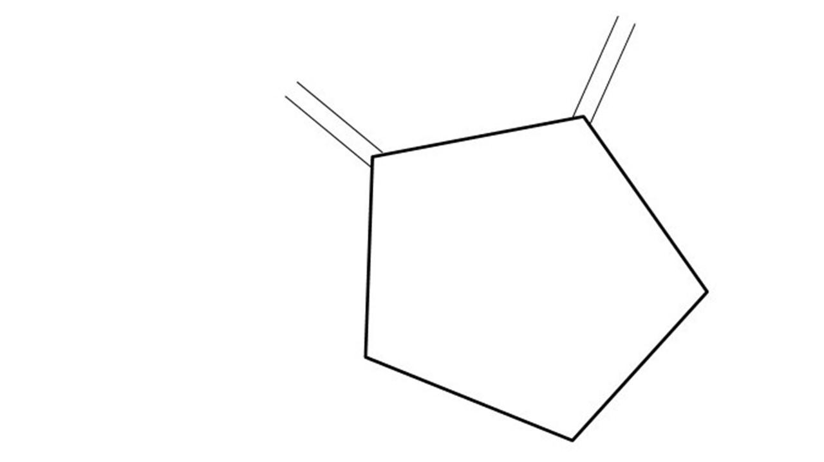
Great Cow BASIC Part 16
Great Cow BASIC for the PIC16F171xx chip Family
October 2022

Slide 2
Videos...
Install the hardware and make the board work – three LED programs
Make four LEDs flash in a sequence
Set the LEDs to represent the value of ADC
Sequence the LEDs with a delay using the value of ADC
Using an input to set the state of the LED
Using the reset switch
Using the switch, ADC – the LEDs flash in a sequence with reverse
Using the serial to display values
Using the timer0 overflow, 8bit timer, 16bit timer to flash the LEDs
Using CCP/PWM to dim the LEDS
Using I²C with serial to discover I2C devices
Using EEProm – showing values on the serial terminal
Using an I²C GCLD display
Using an SPI GCLD display
Using PWM to dim the LEDS
Using memory within the PIC – Progmem and SAF memory
The Great Cow BASIC tool chain
Assembly and alternatives assemblers
Summary

Slide 3
Great Cow BASIC Compiler
Great Cow BASIC is an Open Source compiler for Microchip PIC &AVR and Logic Green AVR microcontrollers
Great Cow BASIC now supports the 16F171xx chip family
Great Cow BASIC Compiler

Slide 4
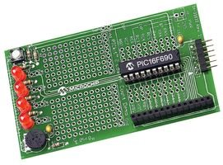
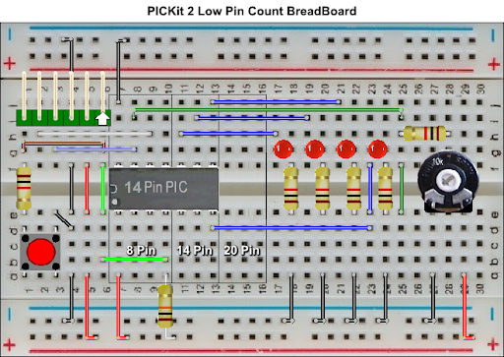

Hardware
Microchip Low Pin Count Demo Board
PICKit_2_Low_Pin_Count_User_Guide_51556a.pdf
By Chris Roper

Slide 5
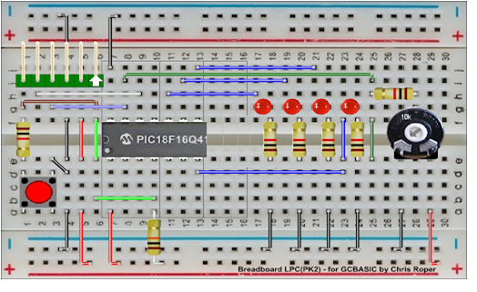
Hardware
GND
Layout
16F17126
By Chris Roper
TX on PORTC.4

Slide 6
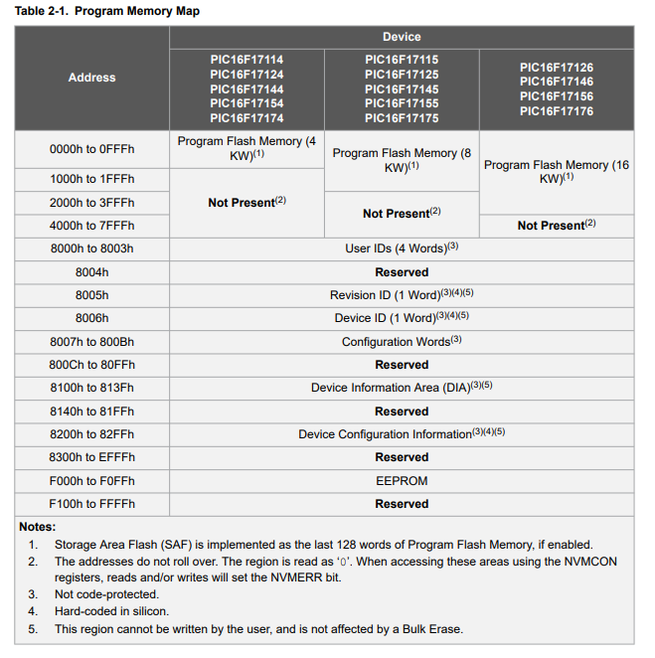
Memory Overview
 | Type | Characteristics
1 | Program Flash | Program, Config, DIA, Storage Area Flash (SAF) block, etc
2 | Data RAM | Volatile
3 | Data Flash (EE) | Consider as a peripheral

Slide 7
Program Flash
 | Type | Characteristics
1 | Program Flash | Program, Config, DIA, Storage Area Flash (SAF) block. etc
2 | Data RAM | Volatile
3 | Data Flash (EE) | Consider as a peripheral
Memory of interest

Slide 8
SAF Block
Storage Area Flash (SAF) is the area in program memory that can be used as data storage.
SAF is enabled by the SAFEN Configuration bit. If enabled, the code placed in this area cannot be executed by the CPU.
SAF block is placed at the end of memory and spans 128 Words.
WRTSAF Configuration bit is used to write-protect the Storage Area Flash.
SAF memory is ONLY the lower byte of each specific memory address.

Slide 9
Data Flash Memory Block
Data Flash Memory (DFM)
Nonvolatile memory array, also referred to as EEPROM.
DFM is readable and writable during normal operation over the entire VDD range.
DFM can only be read and written one byte at a time.
EEPROM

Slide 10
Memory usage - PFM
PROGRAM
B/L
Progmem usage
Your program
and/or
Reference data
Pictures
Uses PFM direct addressing
REF DATA
PFM
or
PROGRAM
PFM
REF DATA

Slide 11
Memory usage - SAF
PFM
PROGRAM
B/L
SAF usage
Reference data
Cannot be overwritten by user program – you MUST adjust program to NOT use SAF block
Uses SAF offset addressing
REF DATA
PFM
PROGRAM
or
PFM
REF DATA
SAF BLOCK – REF DATA
SAF BLOCK – REF DATA

Slide 12

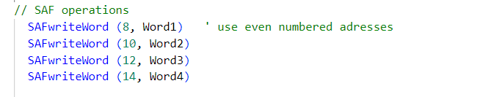
PFM and SAF Memory

Slide 13
Lab
Walk the examples and examine the results
PROGMEM
290_showing_progmem_data_to_serial_terminal
SAF
280_showing_saf_data_to_serial_terminal

Slide 15
PFM and SAF Memory

Slide 16
Videos...
Install the hardware and make the board work – three LED programs
Make four LEDs flash in a sequence
Set the LEDs to represent the value of ADC
Sequence the LEDs with a delay using the value of ADC
Using an input to set the state of the LEDs
Using the reset switch
Using the switch, ADC – the LEDs flash in a sequence with reverse
Using the serial to display values
Using the timer0 overflow, 8bit timer, 16bit timer to flash the LEDs
Using CCP/PWM to dim the LEDS
Using I2C with serial to discover I2C devices
Using EEProm – showing values on the serial terminal
Using an I2C GCLD display
Using an SPI GCLD display
Using PWM to dim the LEDS
Using memory within the PIC – Progmem and SAF memory
The Great Cow BASIC tool chain
Assembly and alternatives assemblers
Summary

Slide 17
Great Cow BASIC
Great Cow BASIC for the PIC16F171xx chip Family
October 2022

